Slide 1
One Mind Summit: Open Science and Collaboration in Action
27-29 May 2015
Collaborating on Standards to Accelerate TBI Research
Presented by Rebecca D. Kush, PhD
President, CDISC

Slide 2

ADAS-Cog Variability
Across Organizations
CDISC Alzheimer’s Disease Standard Now Available!
“It is all about the data and how you can gain maximum utility and insight from data. In a world where many data are being shared, but in differing formats, CDISC standards provide a faster path to gaining those insights.” -Enrique Aviles, CTO, C-Path
 | ADNI | J&J | Wyeth | sanofi-aventis | Pfizer | AstraZeneca | Abbott
Item 1 | Word Recall | Word Recall | Word Recall | Word Recall | Word Recall | Word Recall | Word Recall
Item 2 | Commands | Name Obj/fing. | Name Obj/fing. | Commands | Name Obj/fing. | Name Obj/fing. | Name Obj/fing.
Item 3 | Constr. Praxis | Delayed recall | Commands | Constr. Praxis | Commands | Commands | Commands
Item 4 | Delayed recall | Commands | Constr. Praxis | Delayed recall | Delayed recall | Constr. Praxis | Constr. Praxis
Item 5 | Naming Obj/fing. | Constr. Praxis | Idea Praxis | Name Obj/fing. | Constr. Praxis | Idea. Praxis | Idea. Praxis
Item 6 | Idea. Praxis | Idea Praxis | Orientation | Idea. Praxis | Idea. Praxis | Orientation | Orientation
Item 7 | Orientation | Orientation | Word Recog | Orientation | Orientation | Word Recog | Word Recog
Item 8 | Word Recog. | Word Recog. | Remem. Instr. | Word Recog | Word Recog | Remem. Instr. | Spoken Lang Abil.
Item 9 | Remem Instr. | Remem Instr. | Spoken Lang. Abil. | Remem. Instr. | Remem. Instr. | Spoken Lang. Abil. | Comprehension
Item 10 | Comprehension | Spoken Lang. Abil. | Word Finding Dif. | Spoken Lang Abil. | Spoken Lang Abil. | Word Finding Dif. | Word Finding Dif.
Item 11 | Word Finding Dif. | Word Finding Dif. | Comprehension | Diff. Spont. Speech | Word Finding Dif. | Comprehension | Remem. Instr.
Item 12 | Spoken Lang. Abil. | Comprehension | Concentration | Comprehension | Comprehension | Concentration
Item 13 | Number cancel. | Concentration |  | Concentration | Concentration

Slide 3

CDISC
Clinical Data Interchange Standards Consortium
  Global Standards Development Organization (SDO)
    501(c)(3) charitable non-profit
    Founded in 1997; now > 360 member organizations
    People in ~ 90 countries download CDISC standards
    Liaison A with ISO TC 215 for Healthcare Standards
    Formal relationship with other global SDOs through Joint Initiative Council

Slide 4




U.S. FDA has released Binding Guidance to require CDISC standards in 2016.
Japan’s Pharmaceutical and Medical Devices Agency will require CDISC standards in 2016.
Translational Research Informatics Center in Japan requires CDISC standards for all academic research projects (funded by the Japanese government).
Innovative Medicines Institute in Europe consortia projects are encouraged to use CDISC standards or, if one is not available, participate in the development of that standard. IMI 2 consortia projects will require a data plan and use of standards.

Slide 6








Coalition For Accelerating
Coalition For Accelerating Standards & Therapies
A joint initiative to accelerate clinical research and medical product development by creating and maintaining data standards, tools and methods for conducting research in therapeutic areas that are important to public health
With the enactment of FDASIA/PDUFA V, FDA recognized the opportunity to work with CFAST to develop therapeutic area data standards.
CFAST Steering & Advisory Members (with CDISC and C-Path):
Notes:
6

Slide 7
Program Overview – May 2015
Approved Therapeutic Area Standards Projects
Therapeutic Area | Coordinating Organization/PM | Proposal Approval Date | Stage 0 Scoping | Stage 1 Concept Modeling | Stage 2 Standards Development | Stage 3a Internal Review | *Stage 3b Public Review | *Stage 3c **Projected Publication | Notes
Traumatic Brain Injury v1 | CDISC Amy Palmer | Oct 13 | Dec | Jan | Feb | May | Jun | Q315 | SRC submission for public review soon
Schizophrenia v1 | CDISC/DCRI Amy Palmer | Nov 13 | May | Jul | Aug | Dec | Mar | Q215 | SRC submission for publication soon
Breast Cancer v1 | TCB John Owen | Nov 13 | Aug | Dec | Jan | May | Jun | Q315 | Working on IR comments, waiting on FDA comment
Dyslipidemia v1 | TCB John Glover | Dec 13 | May | Sept | Dec | Mar | Apr | Q215 | SRC submission goal: May 26 Publication goal: middle/end June
COPD v1 | TCB John Glover | Nov 13 | Aug | Dec | Apr | Jun | Aug | Q315 | Internal Review goal: by May 15
ADaM Supplement to Diabetes v1 | TCB Rachael Zirkle | NA | NA | NA | Jan | May | Jun | Q215 | Working on internal review comments
Virology v2 | C-Path Laura Butte | Feb 15 | Mar | Apr | May | Jun |  | Q315 | Internal review to start next week
Diabetic Kidney Disease v1 | TCB Rachael Zirkle | May 14 | May | Jun |  |  |  | Q116 | Submitted charter, starting stage 1
Tuberculosis v2 | C-Path Laura Butte | Dec 14 | Apr | Jun | Aug |  |  | Q116 | Working on stage 1 and stage 2 concurrently
Rheumatoid Arthritis v1 | TCB Trisha Simpson | Jul 13 | May | Jun |  |  |  | Q116 | Sent out TA survey, extended deadline to next Monday
CV Imaging v1 | CDISC/DCRI Amy Palmer | Dec 13 | Apr | Jun |  |  |  | Q216 | Updating charter per TAPSC comments
Prostate Cancer v1 | CDISC John Owen | Oct 14 | May |  |  |  |  | Q216
Key| Stage completed | Stage ongoing | All months reflect when stage is, or is projected to be, completed.
May 20, 2015
*The Stage 3b concludes at the end of the 30-day review period and Stage 3c concludes when all tasks have been completed and the standard is publicly available.
** Specific projected publication dates to be added to the notes section at the conclusion of Stage 3b.

Slide 8

“One Mind is building on the efforts of the [international] TBI Research Community, NIH and the DoD to develop data standards, called Common Data Elements (TBI-CDEs). Your support funded conversion of the TBI-CDEs to an internationally accepted set of Clinical Data Interchange Standards (CDISC), a format approved by the FDA. Efforts have also led to creating standards that will reduce the time required for FDA acceptance of research findings and
accelerate the pace at which new diagnostics and treatments
reach the patient.”
Source: “Connecting the Dots”
(One Mind flyer)

Slide 9

One Mind-CDISC: Project Status and Next Steps
Stage 0 | Stage 1 | Stage 2 | Stage 3a | Stage 3b | Stage 3c | Stage 4
Scoping and Planning | Identification/Modeling of Research Concepts | Development of Draft Standards | Internal Review | Public Review | Public Release | Maintenance & Education
  Completed Stages 0, 1, 2 and 3a – Scoping and Identification/Modeling of Research Concepts; Development of Draft Standards and Internal Review
  Research Concepts Stage included 75 Key Clinical Concepts & ~30 Imaging Concepts
  Supplements & Terminology completed for 18 Questionnaires, Ratings, and Scales
  In progress are Terminology and Supplements for 11 additional Questionnaires, Ratings, and Scales

Slide 10
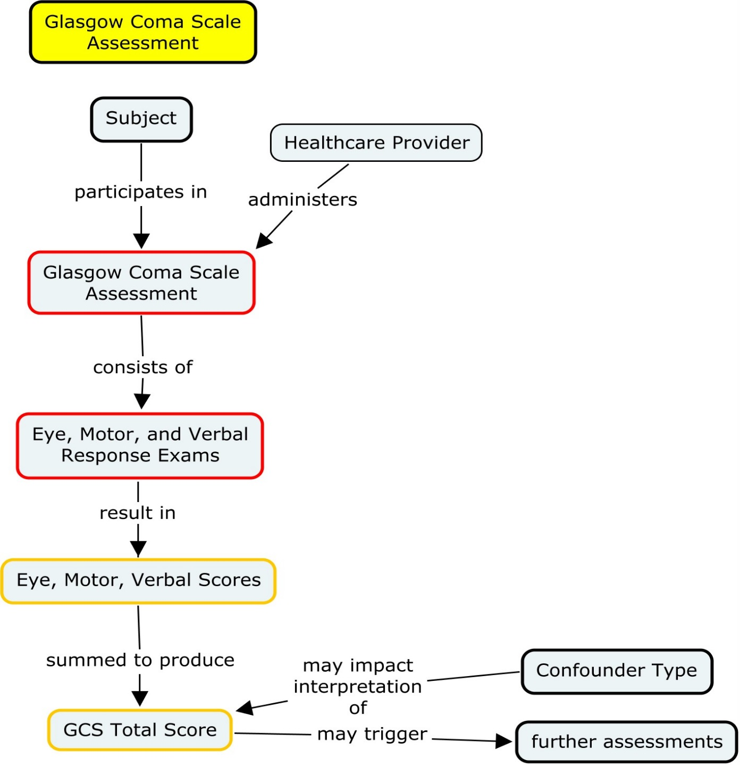
Concept
Map
Example

Slide 11
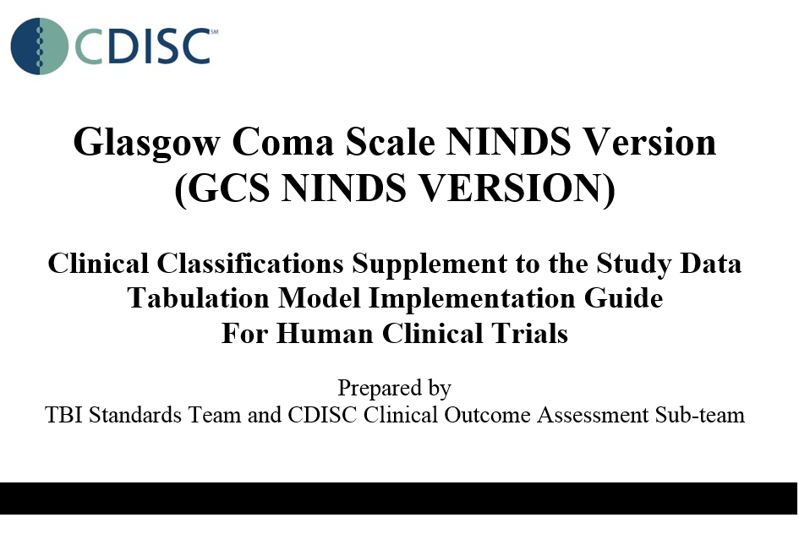
NINDS CDEs Example - Glasgow Coma Scale

Slide 12
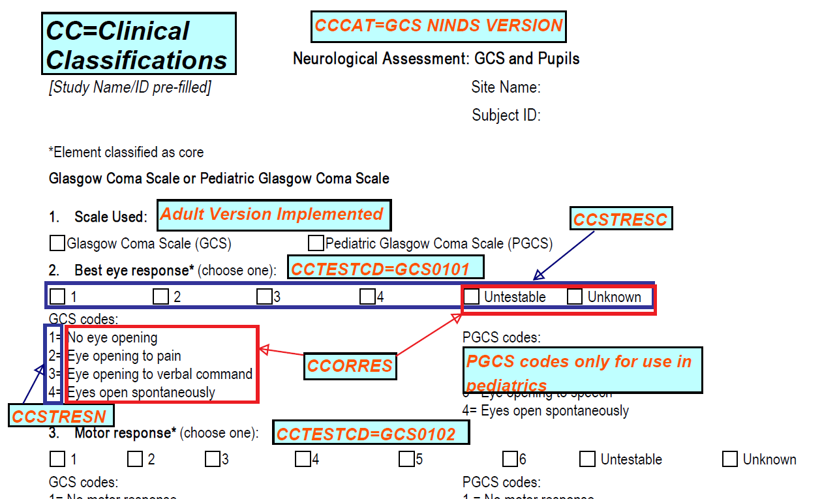
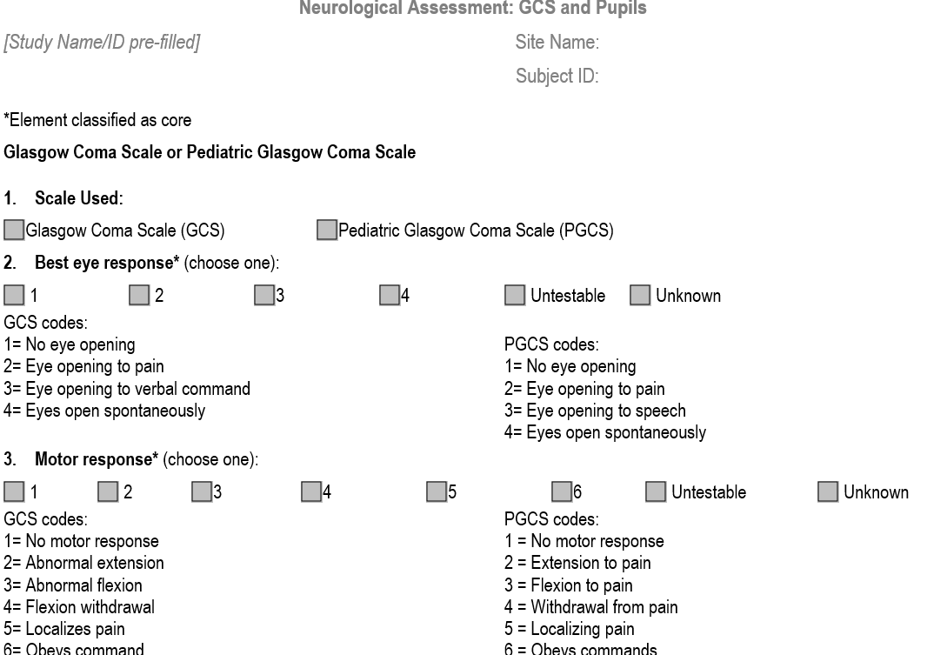
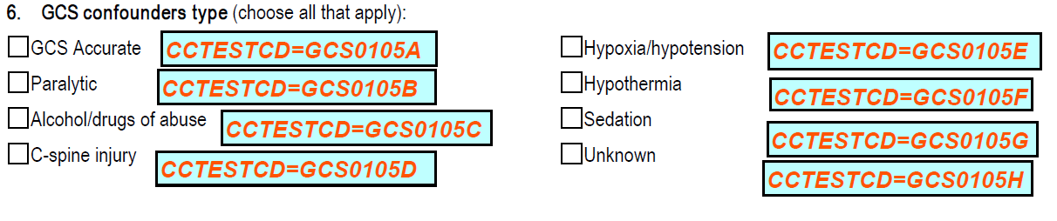

Slide 13
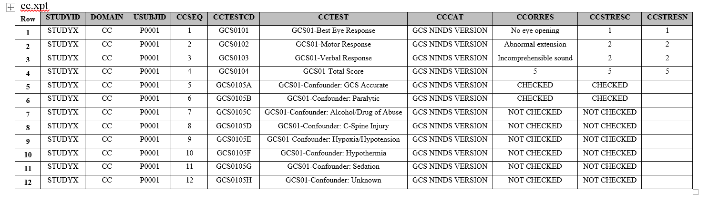
Data Example using CDISC Study Data Tabulation Model (SDTM)
Glasgow Coma Scale
Results from CRF, text and numeric
Questions #2-5 on NINDS CRF – Responses and Total Score
Question #6 on NINDS CRF - Confounders
Question #1 on NINDS CRF Identifies Glasgow Coma Scale

Slide 14
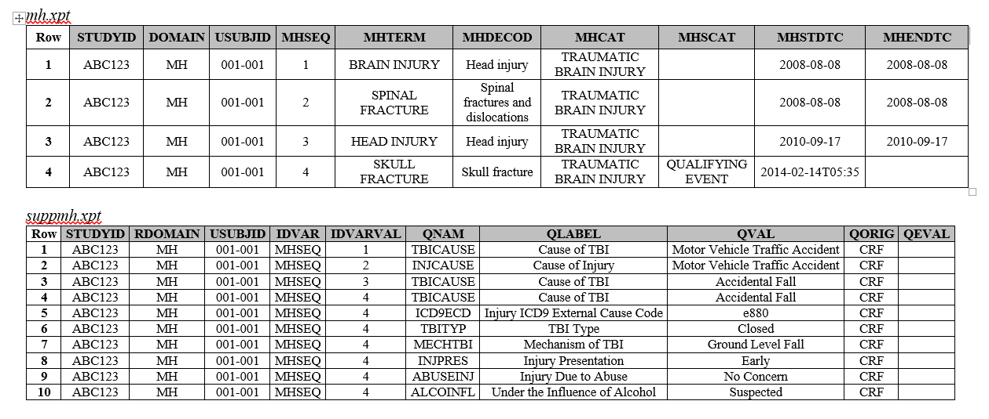
Standards Development Stage
Example: TBI Medical History

Slide 15
CDISC standards specify how to structure the data,
NOT what should be collected nor how to conduct clinical assessments or protocols.

Slide 16
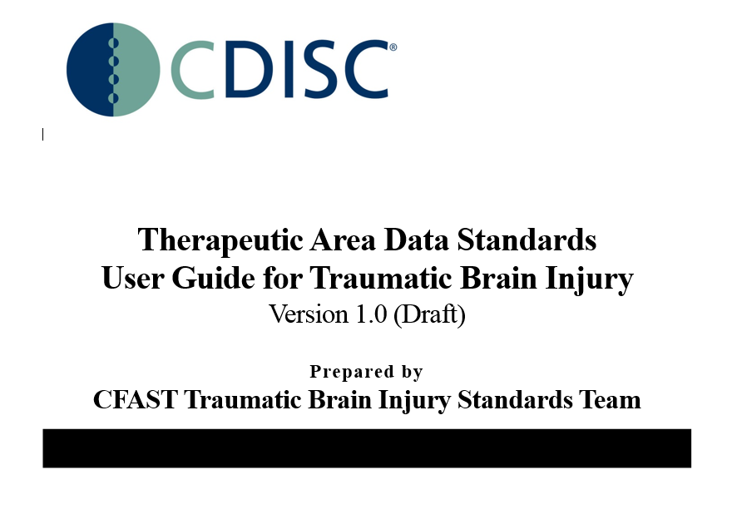

Slide 17
Next Steps
Stage 0 | Stage 1 | Stage 2 | Stage 3a | Stage 3b | Stage 3c | Stage 4
Scoping and Planning | Identification/Modeling of Research Concepts | Development of Draft Standards | Internal Review | Public Review | Public Release | Maintenance & Education
Public Review planned to start in June 2015; overview webinar 11 June
Publish for implementation in Q3 2015
Develop education materials

Slide 18

SHARE is a global electronic repository for developing, integrating and accessing CDISC standards metadata in electronic format.
SHARE should dramatically improve the quality, reusability and integration across CDISC standards and controlled terminologies, and improve interoperability with healthcare.
SHARE is a requirement for standards-based automation,
which is key to ROI from standards implementation
Notes:
What is SHARE:
Single, trusted, authoritative source for CDISC data standards
Concepts, metadata, collections, relationships, value sets across the full spectrum of CDISC content
Aligned with NCI Semantic Systems
Links research to healthcare concepts to support interoperability

Slide 19


“We owe it to patients and research participants to use their data and use it wisely.”

Slide 20































































Atlantic Biomarkers
The Griesser Group
Joyce Hernandez Consulting
Gene Pharmaceuticals, LLC

Slide 21

Strength through collaboration.
21

Slide 22
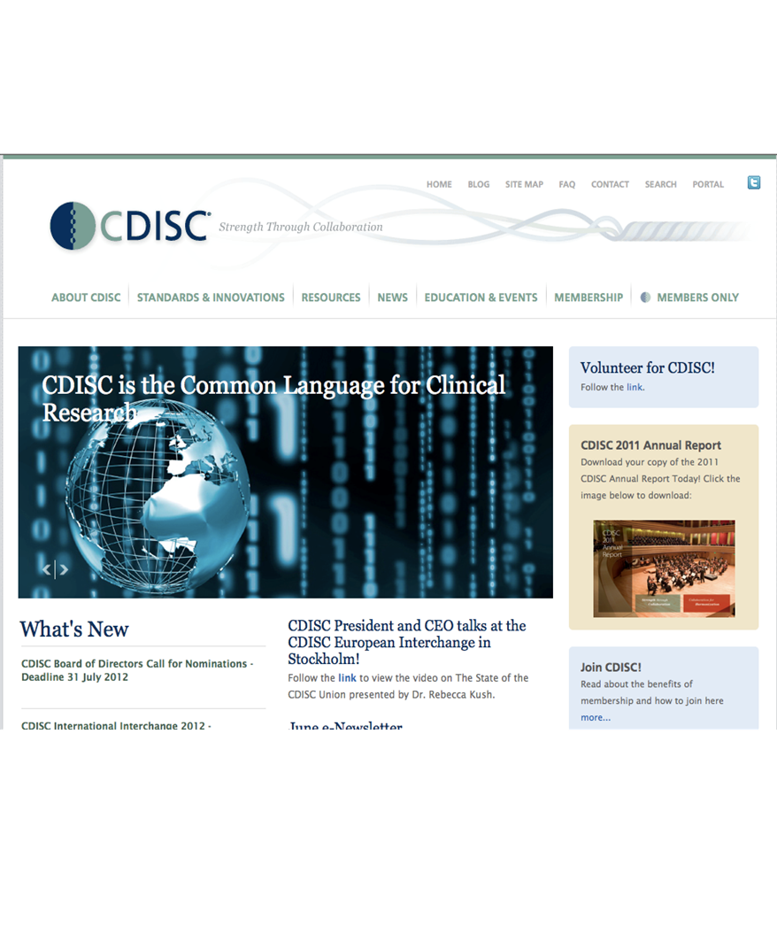
Collaborative, Consensus-based Development
CDISC Standards are Freely Available:
www.cdisc.org

